Slide 1
Lecture 3 Investigating Relationships
Faculty of Computer Science
Data Analysis
Moscow 2022
Lecturer: Alisa Melikyan, amelikyan@hse.ru, PhD,
Associate Professor of the School of Software Engineering

Slide 2
Student’s t-test
Data Analysis
Lecture 3
Investigating Relationships
A t-test is a statistical test that checks if two means are reliably different from each other.
The values of the means may show a difference, but we can’t be sure if that is a reliable difference.
Descriptive statistics only describes the data, but can’t be generalized beyond that. Inferential statistics, like t-test, allows to make inferences about the population beyond our data, generalize the findings to a whole population beyond the sample, that is tested.

Slide 3
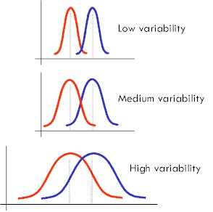
Same means with different variabilities
Data Analysis
Lecture 3
Investigating Relationships

Slide 4
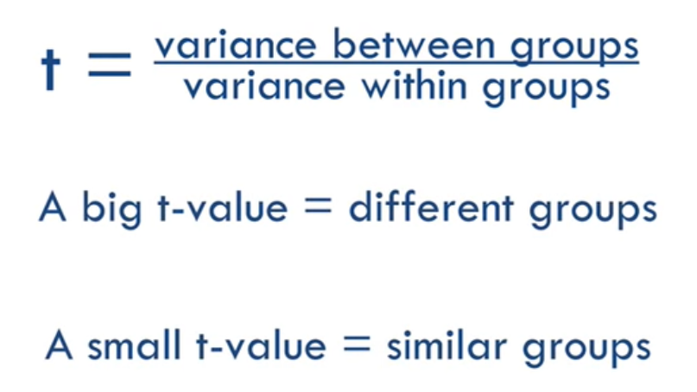
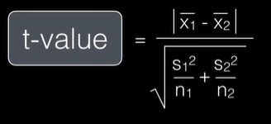
t-test
Data Analysis
Lecture 3
Investigating Relationships

Slide 5
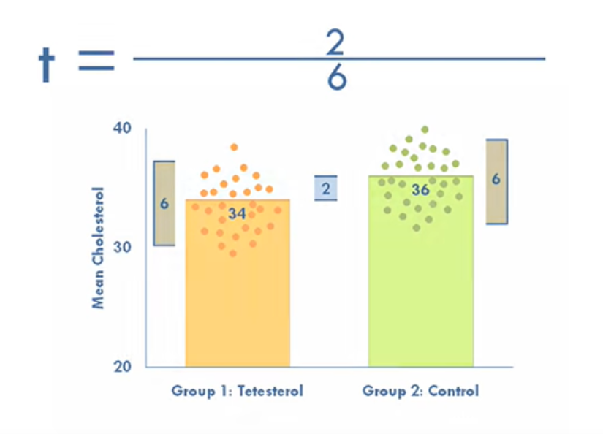
t-test
Data Analysis
Lecture 3
Investigating Relationships
t = 2/6 → the value is not big enough to be reliable → we can’t say that there is a statistically significant difference between the means.
T-distribution calculator: https://stattrek.com/online-calculator/t-distribution.aspx

Slide 6
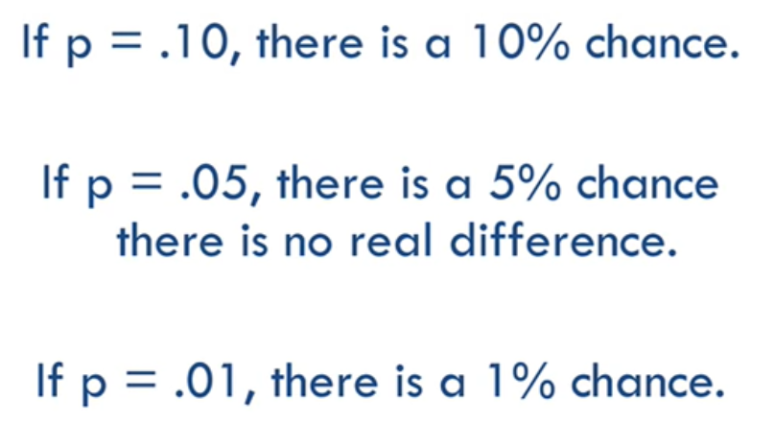
t-test
Data Analysis
Lecture 3
Investigating Relationships
Each t-value has a corresponding p-value, which tells us the likelihood that there is a real difference. P-value is the probability that the pattern produced by our data could be produced by random data. It tells us whether the difference between our groups is real or if it’s just a fluke. The p-value for each t-value depends on the sample size. Bigger samples make it easier to detect differences.

Slide 7
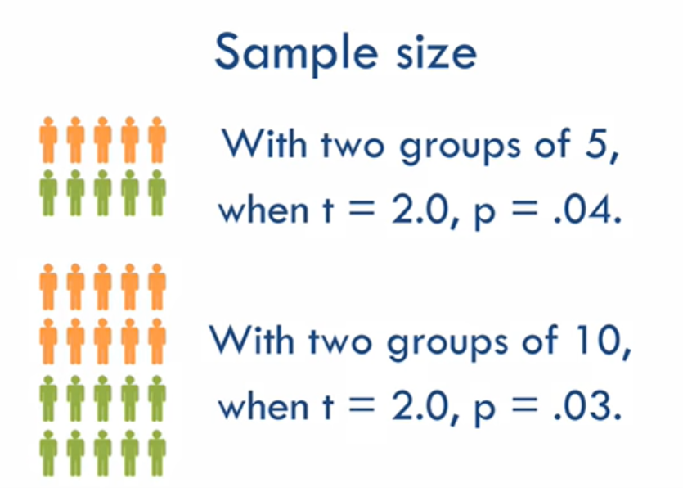
t-test
Data Analysis
Lecture 3
Investigating Relationships

Slide 8
Types of t-test
Data Analysis
Lecture 3
Investigating Relationships
Independent-samples t-test tests the means of two different groups. Is also called between-samples or unpaired-samples t-test.
Paired-samples t-test tests the mean of one group twice. For example, students’ knowledge in statistics before and after passing the course. It’s also called within-subjects, repeated-measures or dependent-samples t-test.
One-sample t-test compares the mean in one group with a hypothetical value or known population mean.

Slide 9
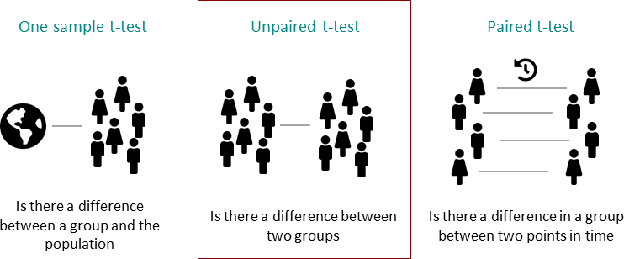
Types of t-test
Data Analysis
Lecture 3
Investigating Relationships

Slide 10
Hypotheses
Data Analysis
Lecture 3
Investigating Relationships
Independent-samples t-test
H1: the mean salaries of men and women are different
Paired-samples t-test
H1: the mean salaries of employees of this organization before and after restructuring are different
One-sample t-test
H1: the mean salary of employees of this organization is different from the average salary in the country

Slide 11
Limitations of t-test
Data Analysis
Lecture 3
Investigating Relationships
The results of inferential statistics can only be applied to populations that resemble the sample that was tested.
The data should be approximately interval-level or higher.
The sample as well as the population should be roughly normal in distribution.
Each group should have about the same number of datapoints, but not less than 20-30.
Scores should not be influenced by each other.

Slide 12
Overcoming several limitations
Data Analysis
Lecture 3
Investigating Relationships
Non-parametric tests do the same job as t-tests, but can be applied to non-normal distributions and ordered-level data. But these tests are less powerful.

Slide 13
Independent Samples t-test
Data Analysis
Lecture 3
Investigating Relationships
The World Bank assigns the world’s economies to four income groups – low, lower-middle, upper-middle, and high-income countries.
H1: the mean values of the percent of travel services our of service exports for high income countries and other countries are different.
Dependent variable: Travel services (% of service exports)
Grouping variable: 1 – high income countries, 0 – other countries.
p-value is 0.0002 < 0.05 → the probability of making an error while rejecting H0 and accepting Ha is very low, we will accept Ha and conclude that there is a statistically significant difference in mean values of the dependent variable in the two groups.

Slide 14
Paired Samples t-test
Data Analysis
Lecture 3
Investigating Relationships
We are analyzing the values of the variable for 2 different years. We have the values of the variable Travel services (% of commercial service exports) for the same countries for two years – 2018 and 2019.
H1: the mean values of the percent of travel services our of commercial service exports for countries in 2018 and in 2019 are different.
p-value is 0.5041 > 0.05 → the probability of making an error while rejecting H0 and accepting Ha is too high, we will reject Ha and conclude that there is no statistically significant difference in mean values of the variable for two time periods.

Slide 15
ANOVA
Data Analysis
Lecture 3
Investigating Relationships
ANalysis Of Variance (ANOVA) tests whether more then two population means are equal or not, and therefore generalizes the t-test beyond two means.
H0: all means are equal m₀ = m₁ = m₂ = … = m_{n}
H1: not all means are equal (at least one pair of means are different)

Slide 16
ANOVA
Data Analysis
Lecture 3
Investigating Relationships
Dependent variable: Travel services (% of service exports)
Grouping variable: 1 – high income countries, 2 – middle income countries, 3 – low income countries
H1: the mean values of the percent of travel services our of service exports for groups of countries based on income are different
H0: mean values are not different
p-value is 0.0001 < 0.05 → the probability of making an error while rejecting H0 and accepting Ha is very low, we will accept Ha and conclude that there is a statistically significant difference in mean values of the dependent variable for the three groups.
Based on this test we can’t conclude in which groups the means are different and in which they are not.

Slide 17
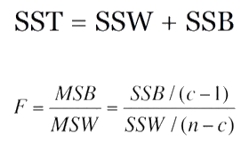
ANOVA
Data Analysis
Lecture 3
Investigating Relationships
The significance of ANOVA is tested based on the value of F statistic.
Number of groups
Number of cases

Slide 18

ANOVA: SST
Data Analysis
Lecture 3
Investigating Relationships
Group 1: 1, 3, 5 Sample mean:
Group 2: 5, 7, 9 (1+3+5+5+7+9+4+5+6)/9 = 5
Group 3: 4, 5, 6
Total sum of squares (SST): 42
(1-5)² + (3-5)² + (5-5)² + (5-5)² + (7-5)² + (9-5)² + (4-5)² + (5-5)²+ (6-5)² = 16 + 4 + 0 + 0 + 4 + 16 + 1 + 0 + 1 = 42

Slide 19
ANOVA: SSW
Data Analysis
Lecture 3
Investigating Relationships
Group 1: 1, 3, 5 mean 1 = (1+3+5)/3 = 3
Group 2: 5, 7, 9 mean 2 = (5+7+9)/3 = 7
Group 3: 4, 5, 6 mean 3 = (4+5+6)/3 = 5
Sum of squares within groups (SSW):
SSW1 = (1-3)² + (3-3)² + (5-3)² = 4 + 0 + 4 = 8
SSW2 = (5-7)² + (7-7)² + (9-7)² = 4 + 0 + 4 = 8
SSW3 = (4-5)² + (5-5)² + (6-5)² = 1 + 0 + 1 = 2
SSW = SSW1+SSW2+SSW3 = 8 + 8 + 2 = 18

Slide 20
ANOVA: SSB
Data Analysis
Lecture 3
Investigating Relationships
Group 1: 1, 3, 5 Sample mean:
Group 2: 5, 7, 9 (1+3+5+5+7+9+4+5+6)/9 = 5
Group 3: 4, 5, 6
Mean 1 = (1+3+5)/3 = 3
Mean 2 = (5+7+9)/3 = 7
Mean 3 = (4+5+6)/3 = 5
SSB1 = 3*(3-5)² = 12
SSB2 = 3*(7-5)² = 12
SSB3 = 3*(5-5)² = 0
SSB = SSB1+SSB2+SSB3 = 12 + 12 + 0 = 24

Slide 21
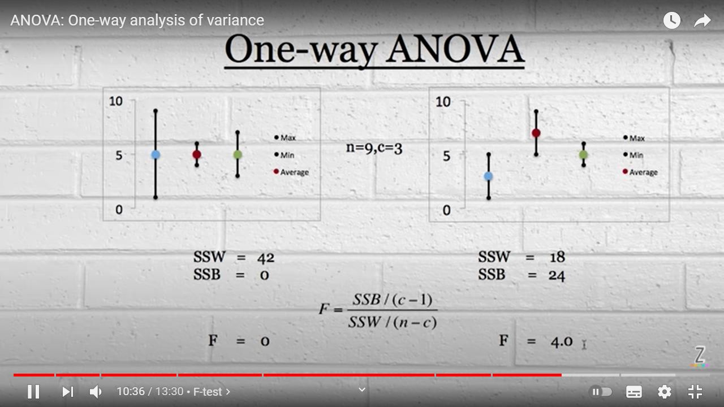
ANOVA
Data Analysis
Lecture 3
Investigating Relationships

Slide 22
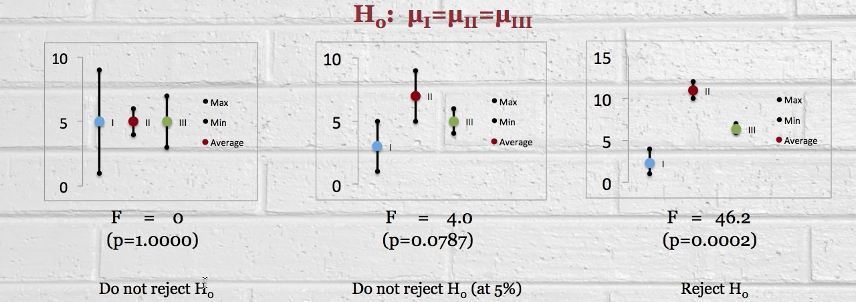
ANOVA
Data Analysis
Lecture 3
Investigating Relationships
Source: https://www.youtube.com/watch?v=9cnSWads6oo

Slide 23
Post-hoc test
Data Analysis
Lecture 3
Investigating Relationships
If ANOVA confirms that the means are not equal we can do pairwise post-hoc testing to determine whether there is a difference between the means of all possible pairs (all pairwise comparisons).

Slide 24
Mann-Whitney U Test
Data Analysis
Lecture 3
Investigating Relationships
Is a non-parametric test, analogue of Independent-samples t-test. Can be performed for ordinal or non-normally distributed interval or ratio scale data.
H_{A}: The two populations are not equal

Slide 25
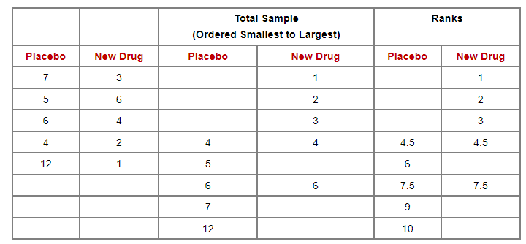
Mann-Whitney U Test
Data Analysis
Lecture 3
Investigating Relationships
https://sphweb.bumc.bu.edu/otlt/mph-modules/bs/bs704_nonparametric/bs704_nonparametric4.html

Slide 26
Wilcoxon signed-rank test
Data Analysis
Lecture 3
Investigating Relationships
Is a non-parametric test, analogue of Paired-samples t-test.
H_{A}: ranks of the group before and after treatment are not equal

Slide 27
Wilcoxon signed-rank test
Data Analysis
Lecture 3
Investigating Relationships
https://sphweb.bumc.bu.edu/otlt/mph-modules/bs/bs704_nonparametric/BS704_Nonparametric6.html#headingtaglink_1
Calculator: https://www.socscistatistics.com/tests/signedranks/default2.aspx
Patient | Before Treatment | After 1 Week of Treatment | Difference (Before-After)
1 | 85 | 75 | 10
2 | 70 | 50 | 20
3 | 40 | 50 | -10
4 | 65 | 40 | 25
5 | 80 | 20 | 60
6 | 75 | 65 | 10
7 | 55 | 40 | 15
8 | 20 | 25 | -5
Ordered Absolute Values of Differences | Ranks | Signed Ranks
-5 | 1 | -1
10 | 3 | 3
-10 | 3 | -3
10 | 3 | 3
15 | 5 | 5
20 | 6 | 6
25 | 7 | 7
60 | 8 | 8
W+ = 32 and W- = 4. The sum of positive and negative ranks is calculated and the smallest sum is selected. As a result, W=4.

Slide 28
Kruskal-Wallis test
Data Analysis
Lecture 3
Investigating Relationships
Is a non-parametric test, analogue of ANOVA.
Null hypothesis: the samples (groups) are from identical populations.
Alternative hypothesis: at least one of the samples (groups) comes from a different population than the others.

Slide 29
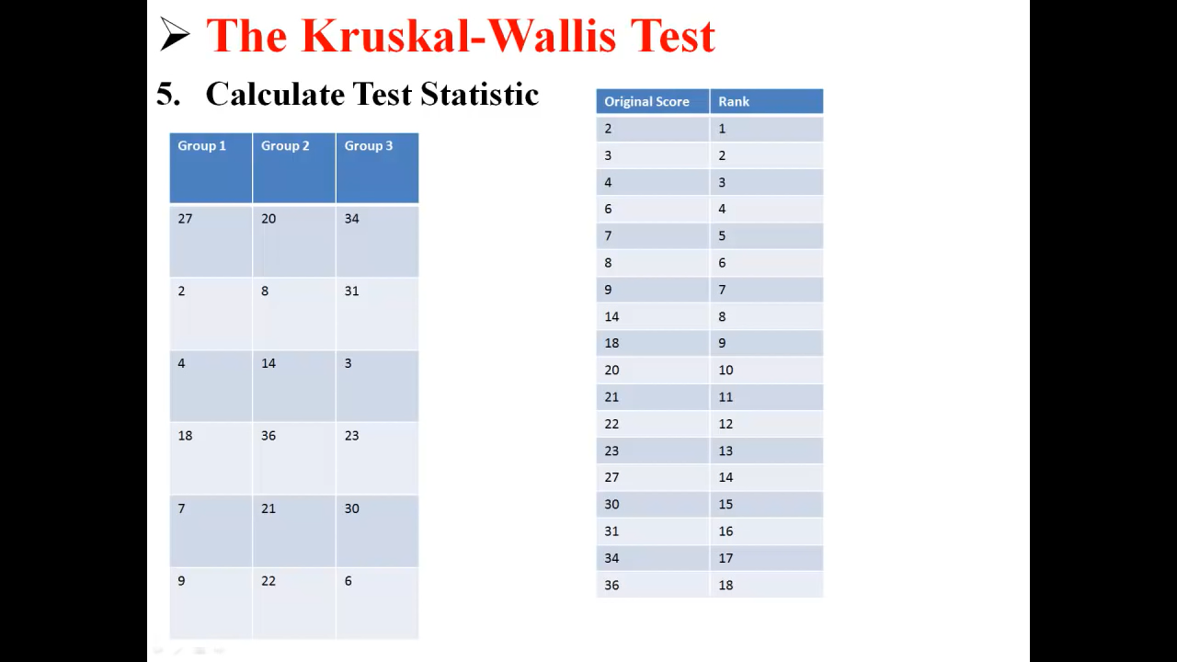
Kruskal-Wallis test
Data Analysis
Lecture 3
Investigating Relationships
First we rank all the values regardless of the group to which they belong.

Slide 30
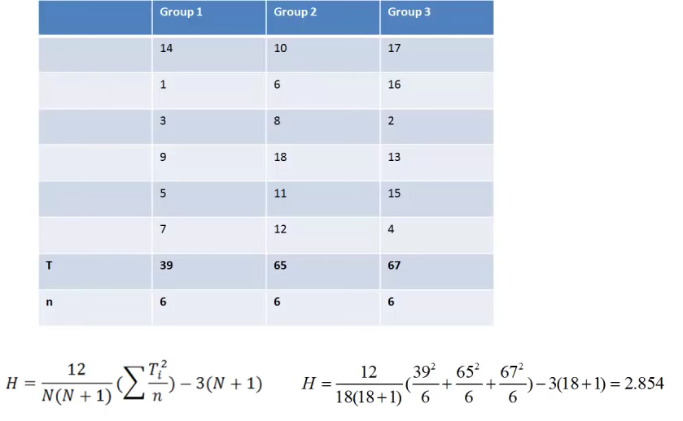
Kruskal-Wallis test
Data Analysis
Lecture 3
Investigating Relationships
https://sphweb.bumc.bu.edu/otlt/mph-modules/bs/bs704_nonparametric/BS704_Nonparametric7.html#headingtaglink_3
Then we replace values with ranks and in each group the sum of the ranks (T) is calculated
Source: https://www.youtube.com/watch?v=BkyGuNuaZYw

Slide 31
Comparing tests
Data Analysis
Lecture 3
Investigating Relationships
Type of samples | Parametric tests | Non-parametric tests
2 independent samples | t-test for two independent samples | Mann-Whitney U test
2 related samples | t-test for two paired samples | Wilcoxon signed-rank test
> 2 independent samples | ANalysis Of VAriance (ANOVA) | Kruskal-Wallis test

Slide 32
Research Articles
Data Analysis
Lecture 3
Investigating Relationships
A study on cross border trade policies & developments with special reference to emerging economies https://www.revistaespacios.com/a18v39n34/a18v39n34p11.pdf
International trade and its effects on economic growth in China https://www.econstor.eu/bitstream/10419/46020/1/657065684.pdf
International Investment (Trade) Factor and Its Effect on GDP: BRICS Case Study http://journals.euser.org/files/articles/ejser_may_aug_14/ErcanE.pdf

Slide 33
Thank you for your attention!
Faculty of Computer Science
Data Analysis
Moscow 2022

